Slide 1


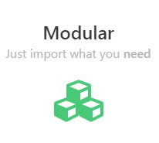
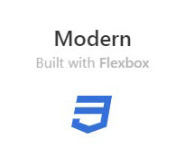


What is Bulma?
Bulma is a Free, Modular And Modern Responsive CSS framework based on Flexbox
An Overview of Bulma Framework

Slide 2
Why Choose
?

Slide 3

Modern features
Using the latest CSS3 features such as Flexbox
Planning on using CSS Variables and CSS Grid

Slide 4

Simple grid System
To build a Bulma grid, you only need a single .columns container to wrap as many .column items as you want

Slide 5
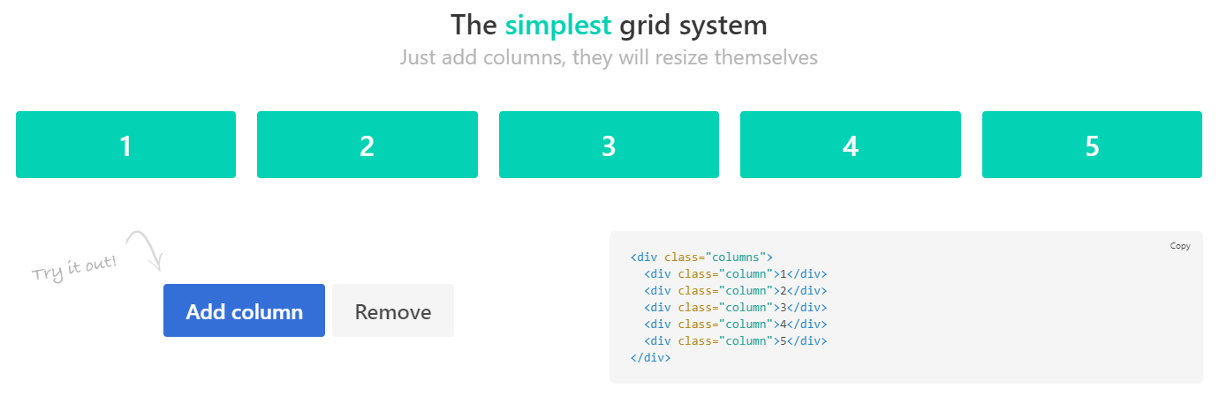

Slide 6
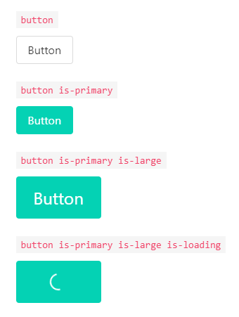

Modern features
Simple readable class names like .button or .title
Straightforward modifiers system like .is-primary
So easy to learn
Get a design started within minutes

Slide 7

Font Awesome 5 support
Bulma is compatible with both Font Awesome 4 and Font Awesome 5 thanks to the .icon element

Slide 8

100+ useful CSS helpers
Bulma ships with more than 100 helpers to specify color, display, and spacing
Responsive helpers
Typography helpers
Other helpers

Slide 9


No JavaScript
By focusing only on CSS, Bulma provides a lightweight solution that can easily be implemented in any development context

Slide 10

So quick to customize
Simply set your own Sass variables before importing Bulma
So easy to learn
Get a design started within minutes

Slide 11

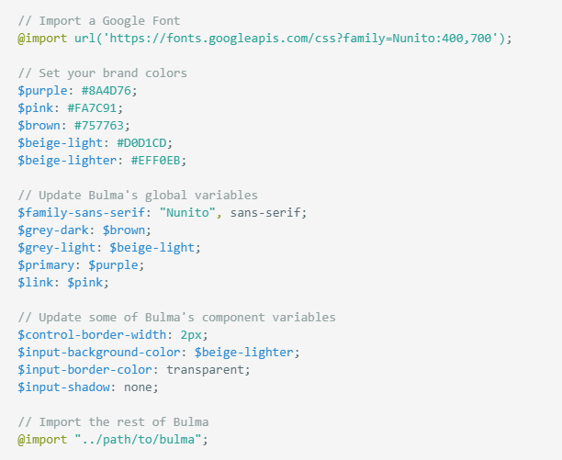
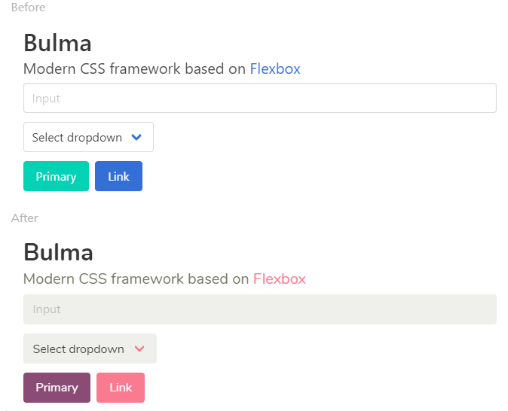
So quick to customize
Simply set your own Sass variables before importing Bulma

Slide 12


Slide 13
